Slide 1

Variational Autoencoders
Auto-Encoding Variational Bayes
What is the Variational Autoencoders?
How to understand Variational Autoencoders?
How does it relate to the Diffusion model
Haruko386
Notes:
啊啊啊啊，数学为什么这么坏 (；′⌒`)

Slide 2
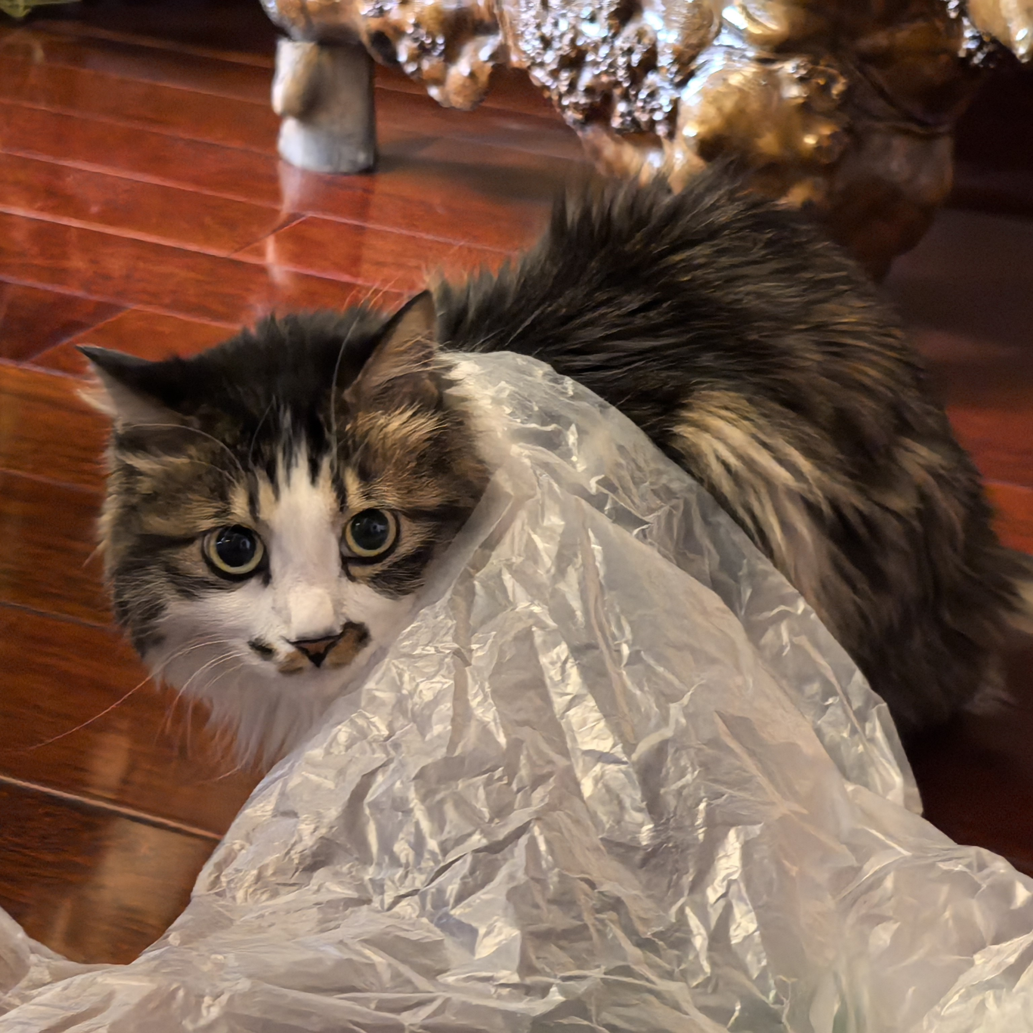
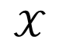
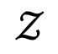
Background: ELBO, KL, VAE and HVAE
[
Width = 3072,
Height = 3072,
Bit depth = 24,
ISO = 2500,
Character = cat,
Env = indoor
………
]
$$𝒳$$
$$𝒵$$
[1] Allegory of the Cave

Slide 3
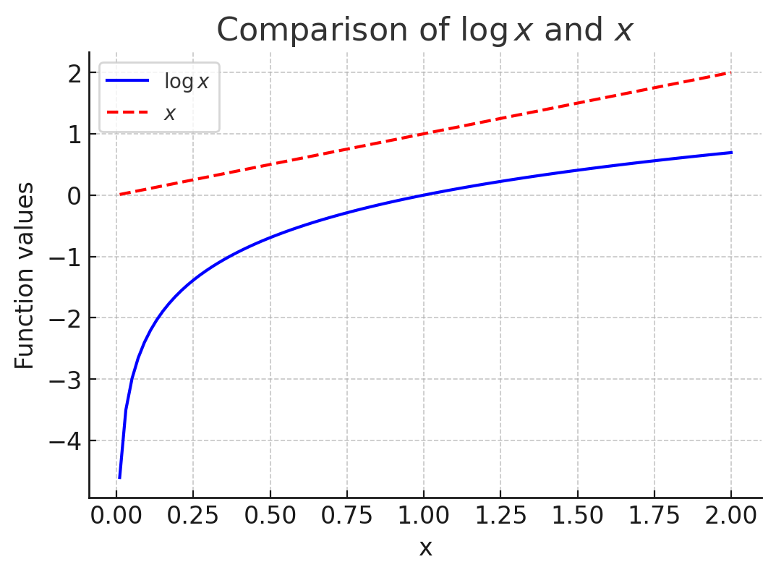
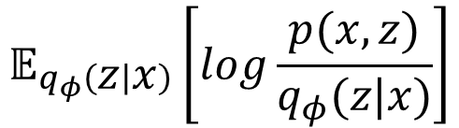
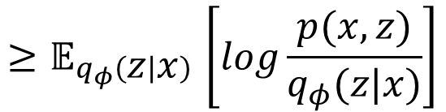
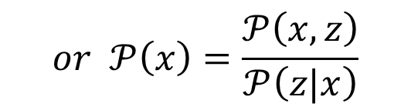
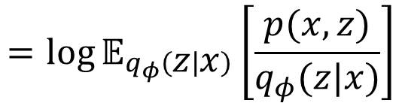
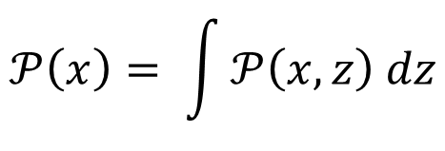
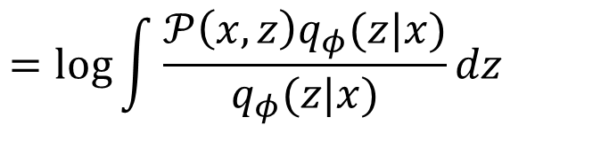
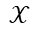
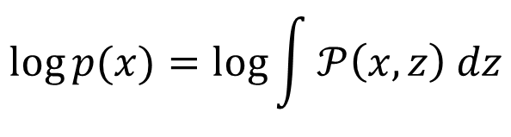
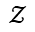
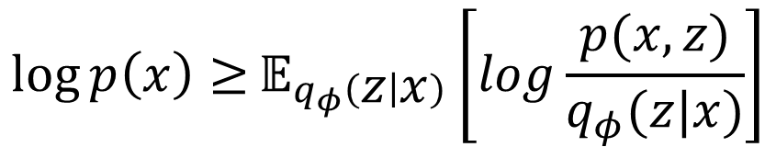
Background: ELBO
[
Width = 3072,
Height = 3072,
Bit depth = 24,
ISO = 2500,
Character = cat,
Env = indoor
………
]
$${\log{p\left(x\right)≥}𝔼}_{q_{φ}\left(z | x\right)}\left[log\frac{p(x,z)}{q_{φ}(z|x)}\right]$$
$$\log{p(x)}=\log{\int{𝒫\left(x, z\right) dz}}$$
$$𝒳$$
$$𝒵$$
$$𝒫\left(x\right)= \int{𝒫\left(x, z\right) dz}$$
$$=\log{\int{\frac{𝒫\left(x, z\right)q_{φ}(z|x)}{q_{φ}(z|x)}dz} }$$
$$or 𝒫\left(x\right)=\frac{𝒫\left(x, z\right)}{𝒫\left(z|x\right)}$$
$$=\log{𝔼_{q_{φ}\left(z | x\right)}\left[\frac{p(x,z)}{q_{φ}(z|x)}\right]}$$
Chain rule (probability)
$$𝔼_{q_{φ}\left(z | x\right)}\left[log\frac{p(x,z)}{q_{φ}(z|x)}\right]$$
$${≥𝔼}_{q_{φ}\left(z | x\right)}\left[log\frac{p(x,z)}{q_{φ}(z|x)}\right]$$

Slide 4
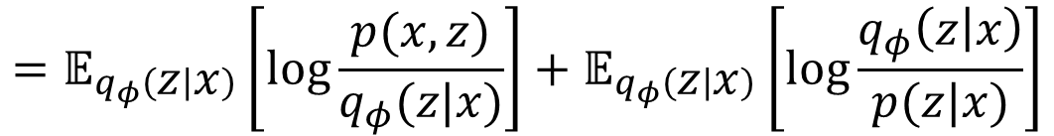
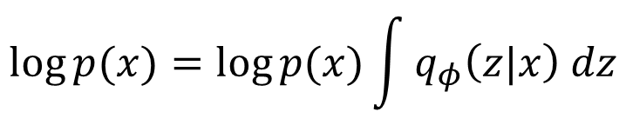
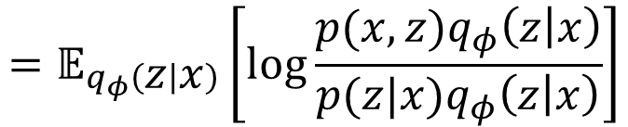
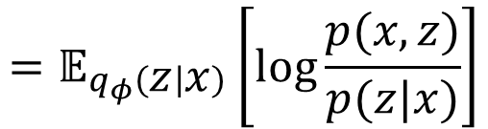
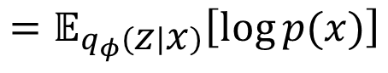
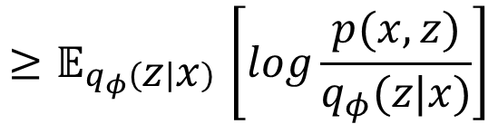
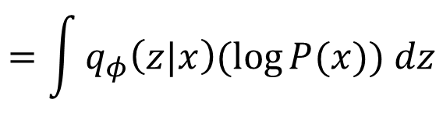
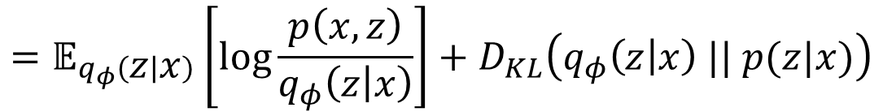
Background: ELBO and KL
Import KL Divergence by performing another derivation
$$\log{p(x)}=\log{p(x)\int{q_{φ}\left(z|x\right) dz}}$$
$$=𝔼_{q_{φ}\left(z | x\right)}\left[\log{\frac{p\left(x,z\right)}{q_{φ}\left(z | x\right)}}\right]+D_{KL}\left(q_{φ}\left(z | x\right) || p(z|x)\right)$$
$$=\int{q_{φ}\left(z|x\right)(\log{P(x)}) dz}$$
$${≥𝔼}_{q_{φ}\left(z | x\right)}\left[log\frac{p(x,z)}{q_{φ}(z|x)}\right]$$
$$=𝔼_{q_{φ}\left(z | x\right)}\left[\log{p(x)}\right]$$
$$=𝔼_{q_{φ}\left(z | x\right)}\left[\log{\frac{p(x,z)}{p(z|x)}}\right]$$
KL Divergence always ≥ 0
$$=𝔼_{q_{φ}\left(z | x\right)}\left[\log{\frac{p(x,z)q_{φ}\left(z | x\right)}{p(z|x)q_{φ}\left(z | x\right)}}\right]$$
$$=𝔼_{q_{φ}\left(z | x\right)}\left[\log{\frac{p(x,z)}{q_{φ}(z|x)}}\right]+𝔼_{q_{φ}\left(z | x\right)}\left[\log{\frac{q_{φ}\left(z | x\right)}{p(z|x)}}\right]$$
Notes:
P(z|x)它对所有可能的 z 进行积分应该等于 1。这是概率密度函数的基本性质

Slide 5

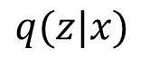
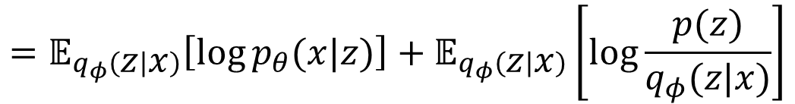

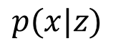
Background: VAE
$$𝔼_{q_{φ}\left(z | x\right)}\left[\log{\frac{p(x,z)}{q_{φ}(z|x)}}\right]$$
$$=𝔼_{q_{φ}\left(z | x\right)}\left[\log{\frac{p\left(x | z\right)p(z)}{q_{φ}(z|x)}}\right]$$
$$p(x|z)$$
x
z
$$=𝔼_{q_{φ}\left(z | x\right)}\left[\log{p_{θ}(x|z)}\right]+𝔼_{q_{φ}\left(z | x\right)}\left[\log{\frac{p(z)}{q_{φ}(z|x)}}\right]$$
$$=𝔼_{q_{φ}\left(z | x\right)}\left[\log{p_{θ}(x|z)}\right]−D_{KL}\left(q_{φ}\left(z | x\right) || p(z)\right)$$
$$q(z|x)$$
reconstruction term
prior matching term
$$q_{φ}\left(z | x\right)=𝒩\left(z;μ_{φ}\left(x\right),σ_{φ}^{2}\left(x\right)Ι\right)$$
$$p\left(z\right)=𝒩(z;0,Ι)$$

Slide 6
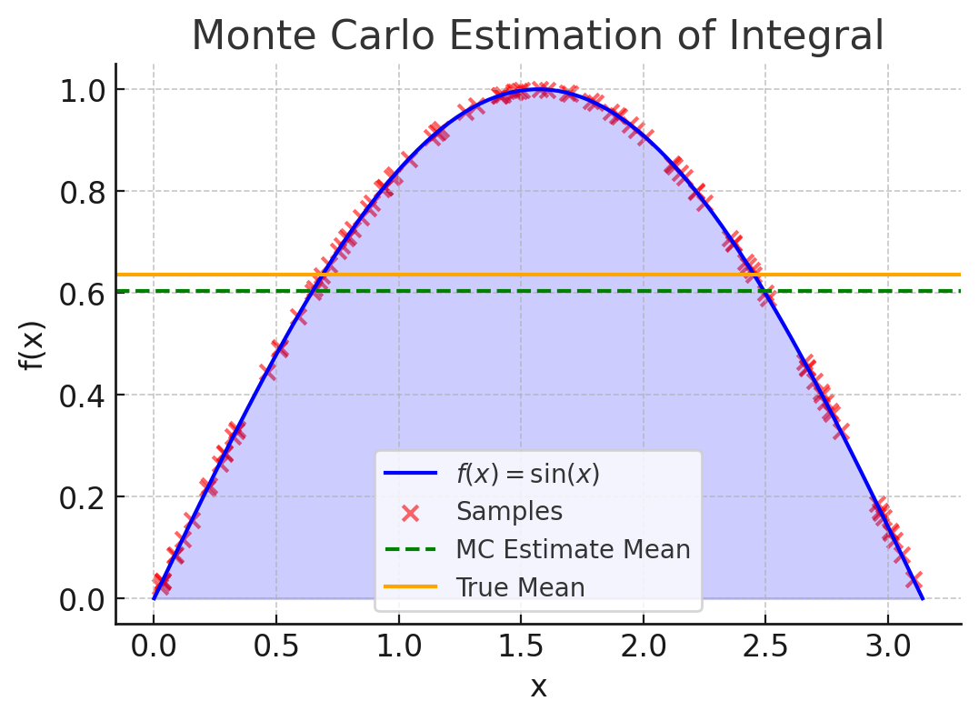
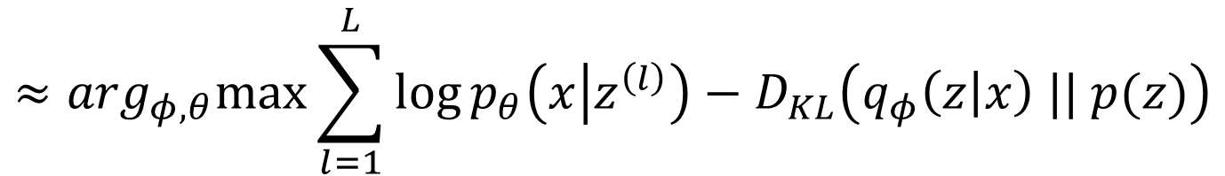
Background: VAE
VAE的目标是最大化ELBO，进而可推导至最大化“重建项”和最小化“KL散度”
$$\arg_{φ,θ}max{ 𝔼}_{q_{φ}\left(z | x\right)\left[\log{p_{θ}(x|z)}\right]−D_{KL}\left(q_{φ}\left(z | x\right) || p(z)\right)}$$
$$≈\arg_{φ,θ}max⁡\sum_{l=1}^{L}{\log{p_{θ}\left(x | z^{\left(l\right)}\right)−D_{KL}\left(q_{φ}\left(z | x\right) || p(z)\right)}}$$
Monte Carlo estimate：计算积分困难的条件下，从分布p(x)中采集N个样本，计算这些样本在f(x)下的平均值，作为期望的近似

Slide 7
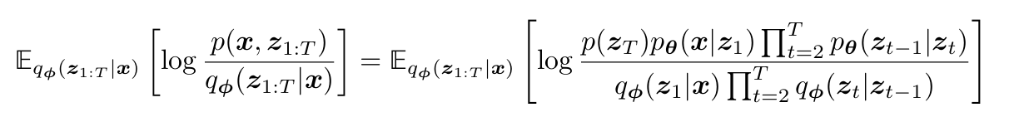
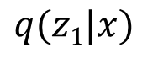
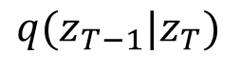
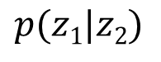
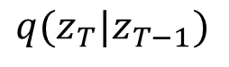
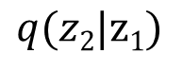
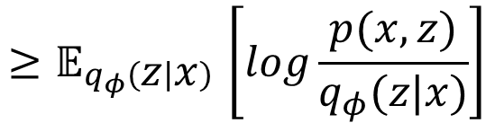
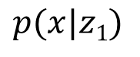
Background: HVAE
$${≥𝔼}_{q_{φ}\left(z | x\right)}\left[log\frac{p(x,z)}{q_{φ}(z|x)}\right]$$
$$p(x|z1)$$
$$p(z1|z2)$$
$$q(z_{T−1}|z_{T})$$
x
z₁
z₂
····
z_{T}
$$q(z1|x)$$
$$q(z2|z1)$$
$$q(z_{T}|z_{T−1})$$

Slide 8
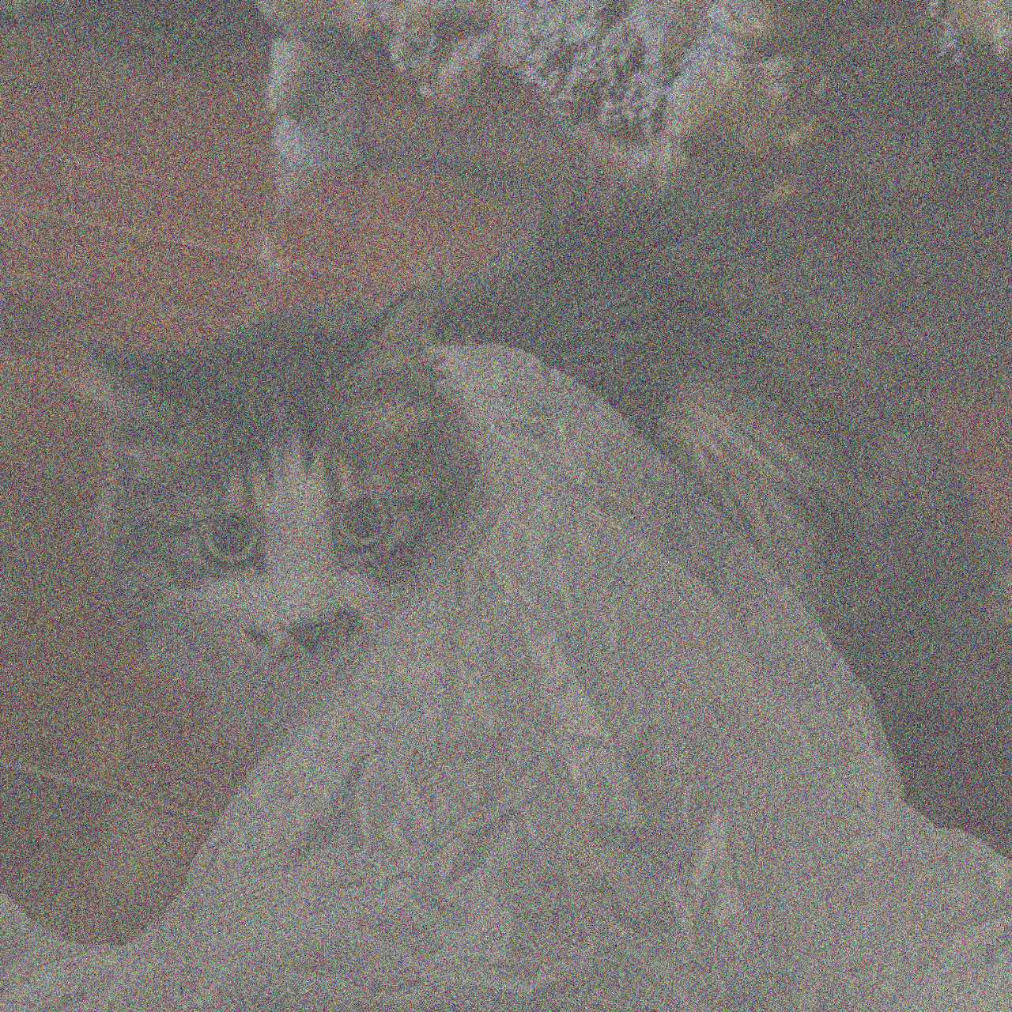
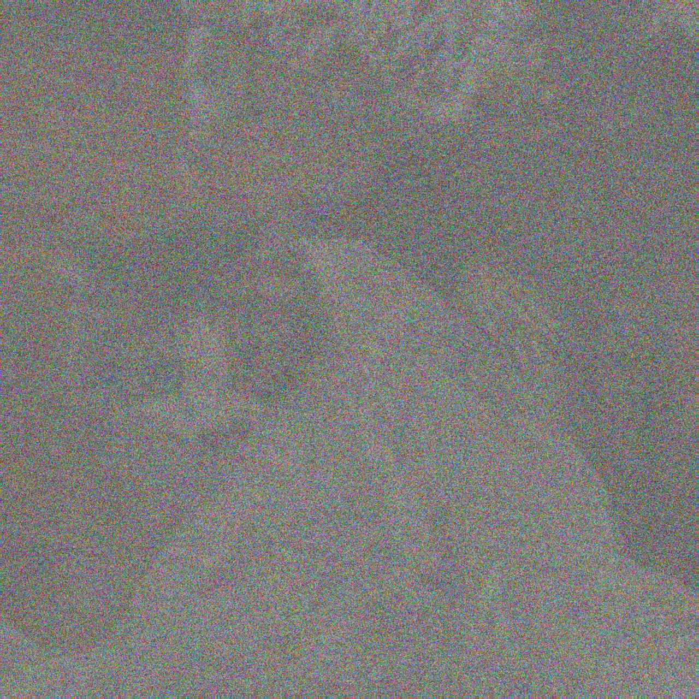

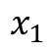
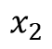
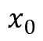
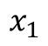
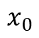
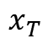
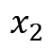
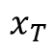
Diffusion Model
Denoising Diffusion Probabilistic Models^{[1]}
Forward Diffusion Process
Data
Noise
$$x_{0}$$
$$x_{1}$$
$$x_{2}$$
$$x_{T}$$
Reverse Diffusion Process
Data
Noise
$$x_{0}$$
$$x_{1}$$
$$x_{2}$$
$$x_{T}$$
[1] Ho J, Jain A, Abbeel P. Denoising diffusion probabilistic models. NeuraIPS, 2020.

Slide 9

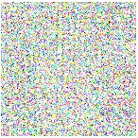

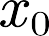
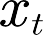

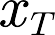



Diffusion Model
Data
+
Noise
+
+
Data
Noise
Denoise Process
-
Model
（t）

Slide 10
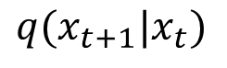









MHVAE and Diffusion Model
$$p(x0|x1)$$
$$p(x_{t−1}|x_{t})$$
$$q(x_{t}|x_{t+1})$$
$$q(x_{T−1}|x_{T})$$
x₀
x_{t-1}
x_{t}
X_{t+1}
····
x_{T}
Relevant only
$$q(x1|x0)$$
$$q(x_{t}|x_{t−1})$$
$$q(x_{t+1}|x_{t})$$
$$q(x_{T}|x_{T−1})$$
1. 我们现在可以将 真实数据样本和潜变量z统一为 $x_{t}$
2.在编码器里，每个潜变量的分布是一个高斯分布，均值围绕着其上一层的潜变量。与 马尔可夫 HVAE 不同，VDM 不学习 每个时间步t的编码器结构，而是将其固定为一个线性高斯模型
$$μ_{t}\left(x_{t}\right)=\sqrt{α_{t}}x_{t−1}$$
$$Σ_{t}\left(x_{t}\right)=(1−α_{t})Ι$$

Slide 11















Forward Diffusion Process
$$q(x_{t}|x_{t−1})$$
Data
Noise
+
Gauss distribution
+
$$x_{0}$$
$$x_{t−1}$$
$$\sqrt{{1−α}_{t}}$$
$$x_{t}$$
$$x_{T}$$
$$\sqrt{α_{t}}$$
+
The reparameterization trick
$$𝓏 \sim 𝒩(μ, σ2)$$
$$\sqrt{α_{t}}$$
$$\sqrt{{1−α}_{t}}$$
$$\frac{𝓏−μ }{σ} \sim 𝒩(0, 1)$$
gaussian
signal
noise
$$𝓏=μ_{φ}\left(x\right)+σ_{θ}\left(x\right)⨀ε$$
$$x_{t}=\sqrt{α_{t}}x_{t−1}+\sqrt{{1−α}_{t}}ε_{t−1}$$
$$ε\sim 𝒩(0, 1)$$
$$q\left(x_{t} | x_{t−1}\right)=𝒩(x_{t};\sqrt{α_{t}}x_{t−1},({1−α}_{t})Ι)$$
mean
variance
Notes:
并不是简单的加一个高斯噪声，而是通过一个线性组合的方式加噪
Q这个加噪过程符合一个高斯分布

Slide 12










Forward Diffusion Process
① forward (close-form)
$$x_{t}=\sqrt{α_{t}}x_{t−1}+\sqrt{1−α_{t}}ε_{t−1}$$
Noise
$$=\sqrt{α_{t}}(\sqrt{α_{t−1}}x_{t−2}+\sqrt{1−α_{t−1}}ε_{t−2})+\sqrt{1−α_{t}}ε_{t−1}$$
$$=\sqrt{α_{t}α_{t−1}}x_{t−2}+(\sqrt{α_{t}−{α_{t}α}_{t−1}}ε_{t−2}+\sqrt{1−α_{t}}ε_{t−1})$$
$$IF x∼𝒩\left(μ_{x},σ_{x}^{2}\right) Y∼𝒩(μ_{y},σ_{y}^{2})$$
$$Z=X+Y$$
$Then Z$ $∼𝒩\left(μ_{x}+μ_{y},σ_{x}^{2}+σ_{y}^{2}\right)$
···
Noise
$$=\sqrt{α_{t}α_{t−1}···α_{1}α_{0}}x_{0}+\sqrt{1−{α_{t}α}_{t−1}···α_{1}}ε$$
$$=\sqrt{\overline{α_{t}}}x_{0}+\sqrt{1−\overline{α_{t}}}ε$$

Slide 13





Reverse Diffusion Process
Markov
$$q(x_{t}|x_{t−1})$$
Data
Noise
+
+
$$q(x_{t−1}|x_{t})$$
impossible!
$q(x_{t−1}|x_{t},x_{0})$ ?
$$p_{θ}(x_{t−1}|x_{t})$$
Neural Network
Assume: the output is gaussian
Target Distribution
$$q\left(x_{t−1} | x_{t}\right)=𝒩(x_{t−1};μ_{t}\left(x_{t}\right),Σ_{t}(xt))$$
Approximated Distribution
$$p_{θ}\left(x_{t−1} | x_{t}\right)=𝒩(x_{t−1};μ_{θ}\left(x_{t},t\right),Σ_{θ}\left(xt,t\right))$$

Slide 14






Maximum Likelihood Estimation
[1]
$$\arg{\max_{θ}{\prod_{i=1}^{t}{p_{θ}(x_{i})}}}$$
$$\arg{\max_{θ}{\sum_{i=1}^{t}{\log{p_{θ}(x_{i})}}}}$$
② optimization (view 1)
min
min
ELBO
min
[1] Luo C. Understanding diffusion models: A unified perspective[J]. arXiv preprint arXiv:2208.11970, 2022.
Notes:
找到某一参数，使得模型生成的图像是正确的概率是比较高的

Slide 15













What is $q(x_{t−1}|x_{t},x_{0})$
If we know
$$x_{0}$$
and
$$x_{t}$$
？
$$q\left(x_{t−1} | x_{t},x_{0}\right)$$
is deterministic
Assume: Markov
$$q\left(x_{t−1} | x_{t},x_{0}\right)=\frac{q(x_{t−1},x_{t},x_{0})}{q(x_{t},x_{0})}=\frac{q\left(x_{t} | x_{t−1}\right)q\left(x_{t−1} | x_{0}\right)q(x_{0})}{q\left(x_{t} | x_{0}\right)q(x_{0})}=\frac{q\left(x_{t} | x_{t−1}\right)q(x_{t−1}|x_{0})}{q(x_{t}|x_{0})}$$
$$q(x_{t}|x_{t−1})∼𝒩(x_{t};\sqrt{α_{t}}x_{t−1}, 1−α_{t})$$
$$\sqrt{α_{t}}$$
$$\sqrt{{1−α}_{t}}$$
$$q(x_{t−1}|x_{0})∼𝒩(x_{t−1};\sqrt{{\overline{α}}_{t−1}}x_{0}, 1−{\overline{α}}_{t−1})$$
$$\sqrt{{\overline{α}}_{t−1}}$$
$$\sqrt{1−{\overline{α}}_{t−1}}$$
$$q(x_{t}|x_{0})∼𝒩(x_{t};\sqrt{\overline{α_{t}}}x_{0}, 1−\overline{α_{t}})$$
$$\sqrt{\overline{α_{t}}}$$
$$\sqrt{1−\overline{α_{t}}}$$

Slide 16






What is $q(x_{t−1}|x_{t},x_{0})$
③ reverse
If we know
$$q(x_{t}|x_{t−1})∼𝒩(x_{t};\sqrt{α_{t}}x_{t−1}, 1−α_{t})$$
$$q\left(x_{t−1} | x_{t},x_{0}\right)∝𝒩(x_{t−1};\frac{\sqrt{α_{t}}\left(1−\overline{α_{t−1}}\right)x_{t}+\sqrt{{\overline{α}}_{t−1}}\left(1−α_{t}\right)x_{0}}{1−\overline{α_{t}}},\frac{(1−α_{t})(1−{\overline{α}}_{t−1})}{1−{\overline{α}}_{t}}Ι)$$
$$q(x_{t−1}|x_{0})∼𝒩(x_{t−1};\sqrt{{\overline{α}}_{t−1}}x_{0}, 1−{\overline{α}}_{t−1})$$
$$q(x_{t}|x_{0})∼𝒩(x_{t};\sqrt{\overline{α_{t}}}x_{0}, 1−\overline{α_{t}})$$
$$μ_{q}(x_{t},t)$$
$$Σ_{q}(t)$$
Assume: fixed
Minimize the distance between two Gaussian distributions (refer to PRML)
Notes:
我们需要拟合两个分布，一个是我们预先定义好的加噪分布，另一个为上述的去噪过程的分布

Slide 17









Remove $x_{0}$
③ reverse
If we know
$$q\left(x_{t−1} | x_{t},x_{0}\right)∝𝒩(x_{t−1};\frac{\sqrt{α_{t}}\left(1−\overline{α_{t−1}}\right)x_{t}+\sqrt{{\overline{α}}_{t−1}}\left(1−α_{t}\right)x_{0}}{1−\overline{α_{t}}},\frac{(1−α_{t})(1−{\overline{α}}_{t−1})}{1−{\overline{α}}_{t}}Ι)$$
$$μ_{q}(x_{t},t)$$
$$Σ_{q}(t)$$
$$x_{0}=\frac{x_{t}−\sqrt{1−\overline{α_{t}}}ε_{0}}{\sqrt{\overline{α_{t}}}}$$
① forward (close-form)
$$x_{t}=\sqrt{\overline{α_{t}}}x_{0}+\sqrt{1−\overline{α_{t}}}ε_{t}$$
$$\frac{\sqrt{α_{t}}\left(1−\overline{α_{t−1}}\right)x_{t}+\sqrt{{\overline{α}}_{t−1}}\left(1−α_{t}\right)x_{0}}{1−\overline{α_{t}}}$$
$$\frac{1}{\sqrt{α_{t}}}(x_{t}−\frac{1−α_{t}}{\sqrt{1−\overline{α_{t}}}}ε_{0})$$
noise predictor
$$ε_{θ}(x_{t},t)≈ε_{0}⇒μ_{q}$$
Notes:
$只有ε$是不知道的，因此我们的神经网络做的就是预测$ε$

Slide 18




Illustration of training
1. Randomly select a time step and encode it.
3. Train the UNet.
Noisy image
encode
Time step embedding
Time step embedding
2. Add noise to image.
UNet
=
$$\sqrt{α_{t}}$$
+
$$\sqrt{{1−α}_{t}}$$
$$ℒ_{L2}$$
Noisy image
Original image
Gaussian noise
Predicted noise

Slide 19



Application in Depth Estimation
CVPR 2024
Vitor Guizilini*
CVPR 2024
Bingxin Ke
CVPR 2024
Yiqun Duan

Slide 20







Showcase
Diffusion Depth: A guided diffusion approach for monocular depth estimation

Slide 21
Showcase
Diffusion Depth: A guided diffusion approach for monocular depth estimation

Slide 22

The end
Reference:
Ho J, Jain A, Abbeel P. Denoising diffusion probabilistic models. NeuraIPS, 2020.
Duan Y, Guo X, Zhu Z. Diffusiondepth: Diffusion denoising approach for monocular depth estimation[C]//European Conference on Computer Vision, 2024
Liu, Ze, et al. "Swin transformer: Hierarchical vision transformer using shifted windows." Proceedings of the IEEE/CVF international conference on computer vision. 2021.
Luo C. Understanding diffusion models: A unified perspective[J]. arXiv preprint arXiv:2208.11970, 2022.
Contact:
E-mail: Haruko386@outlook.com
Github: github.com/Haruko386
You can find all my report here
“
笨蛋小咪出镜→
The sculpture is already complete within the marble block before I start my work. It’s already there, I just have to chisel away the superfluous material
”
——Michelangelo
Notes:
真能做出来吗(￣_￣|||)

